Slide 1

SQLdm 5.1
Plan of Record
August 27, 2007
www.idera.com

Slide 2
Version History
Name | Version | Date | Comments
Heather Sullivan | 1 | 11/6/06 | Starting list of features
Heather Sullivan | 2 | 5/16/07 | Prioritizing and detailing out various features including transaction log viewing
Heather Sullivan | 3 | 8/27/07 | Finalizing before doing 2nd presentation to DM Team. Reprioritized, added a few things, etc.
Heather Sullivan | 3.1 | 3/29/07 | Modified application security requirements, verified requirements, added scoping sections, reprioritized, etc.
www.idera.com

Slide 3
SQLdm Goals
Financial Goals
  Target FY2008 - (34% growth…same as last FY growth)
Solution Goals
  Need to move SQLdm into problem diagnostics and resolution (‘Click n Fix’)
  Need to put ‘Joe’ out of business by providing ‘Joe in a box’

Slide 4
Release Timelines
 | Jun | July | Aug | Sept | Oct | Nov | Dec | Jan | Feb | Mar | Apr | May
5.0
5.0H1
5.0H2
5.1
5.2
Version | Key Features | Target Release Date
5.0 | 3 Tier Architecture | August 2007
5.0 (SP) | 5.0 Issues | October 2007
5.0 (SP) | 5.0 Issues | November/December 2007
5.1 | Theme: Complete Data Capture and Storage Capabilities | January/February 2008
5.2 | Theme: First steps towards Joe in a Box | June/July 2008
www.idera.com

Slide 5
SQLdm 5.1 (Marfa) Overview
Project
  Version: 5.1
  Codename: TBD
  Theme: Complete Data Capture and Storage Capabilities
  Beta: TBD
  Target GA: Early Q1, 08
Team
  Product Manager: Heather Sullivan
  Dev Lead: Shekhar Vaidya
  Doc Lead: Marlowe Wakeman
  QA Lead: Adam Condron
Features - Must
  App Security
  Historical Snapshots
  Allow user enter any metric
  Store real-time data/alert
  Alert based on past perf
Nice
  Worst Performing Improvements
  Scheduled Maint Mode
  Strip parameters off stored procedures
  Reports
  Idera Product Integrations
Is Not
  TBD
www.idera.com

Slide 6
5.1 Release Breakdown
Revenue | Features/Usability Improvements | Commitments
 | Expanded Application Security/Delegation (Servers to monitor, SQLdm administration actions against SQL Servers) Historical Snapshots (data) Scheduled maintenance mode Strip-off parameters in query monitor Allow user to add any metric Store real-time data and have it affect alerts Alert thresholds based on past performance Worst Performing Improvements Additional/Improved Reporting Additional Idera Integrations | Windows Longhorn Monitor 300 Servers per CS Break-apart MS/CS
Revenue: The primary purpose of the feature is to drive, maintain or affect revenue
Expansion: Features that improve usability or features
Commitments: The list of prior prospect, customer or corporate commitments.
www.idera.com

Slide 7
Features
Expanded Application Security (Servers to monitor, SQLdm administration actions against SQL Servers)
Historical Snapshots (including historical process data, etc)
Store real-time data and have it affect alerts.
Allow user to enter any metric
Alert based on ‘past performance’
Scheduled maintenance mode
Strip parameters off the stored procedures in worst performing/most frequent
Additional/Improved Reporting
Worst performing Improvements
Idera Product Integrations
www.idera.com

Slide 8
Application Security/Delegation
Problem
  Customers have DBAs that manage specific servers and they want to be able to limit the servers they can see to only the ones they manage.
  Customers also have different types of users (DBAs, Operators, Help Desk Users, etc) and they want to limit access to certain functionality
  I want to get rid of the Web Console and can’t until I have a read-only solution.
  This question is often raised during evaluation
Solution
  Provide the ability for a users to be defined as the SQLdm Administrator
  Provide the ability for a SQLdm Administrator to define what servers a SQLdm User can see and do in SQLdm
  Provide the ability for a SQLdm Administrator to specify which specific Windows User(s) can access which SQL Servers and whether or not they have read-only or full access
  Out of the box, we should default to every user having full control to all registered servers
Scope
  This is an important feature, but in some cases will be a check-box feature. It is not expected that this feature will be rich in capabilities
  Cheap and simple is good!
www.idera.com

Slide 9
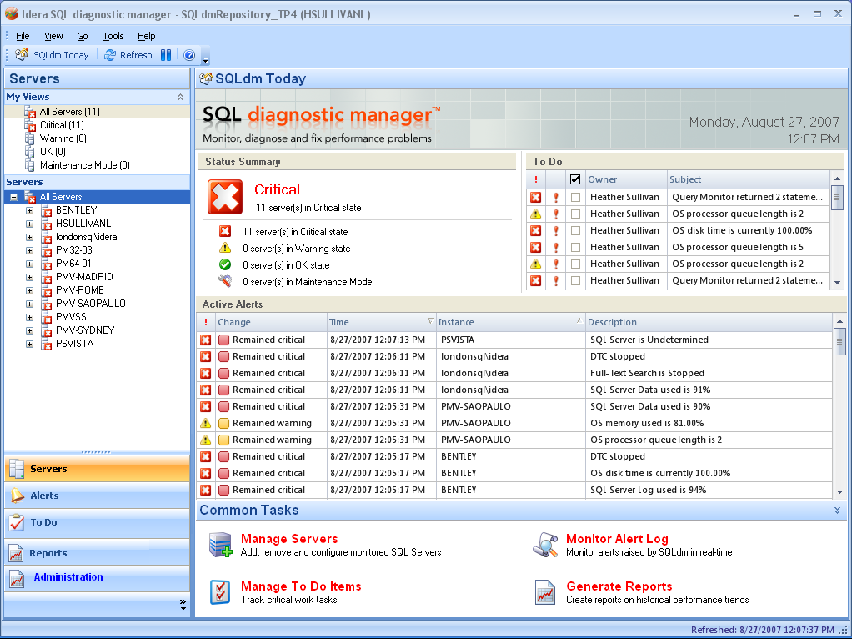
Application Security/Delegation
www.idera.com

Slide 10
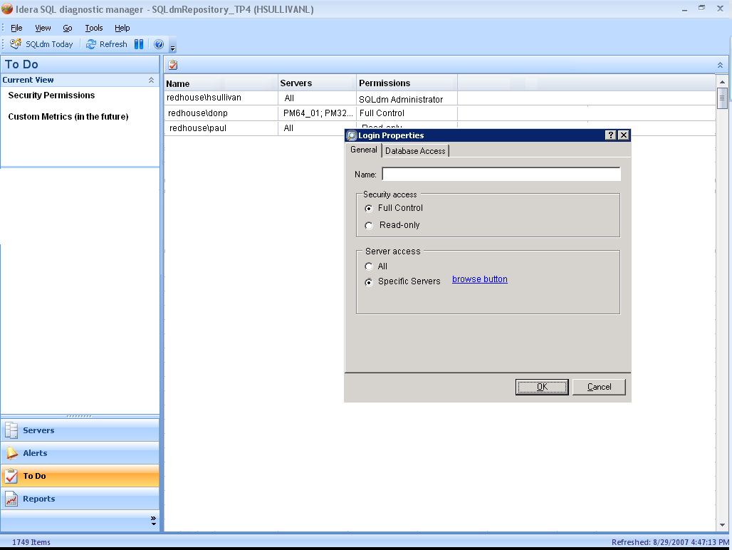
www.idera.com

Slide 11
Historical Snapshots
Problem
  Currently, when a customer receives an alert it is not possible for them to open up the SQLdm Console and determine the state of the server at that particular time (in the past)
Solution
  We need to store additional information (process info, etc.) historically in our repository for the last x days (added to our grooming routines)
  We need to provide a way for a user to pick a historical ‘snapshot’ date/time and have the server views all change to display the information from that particular date/time
  We need to introduce another grooming parameter to groom this extra (large amount) of data
Scope
  This feature is critical and completeness is important
www.idera.com

Slide 12
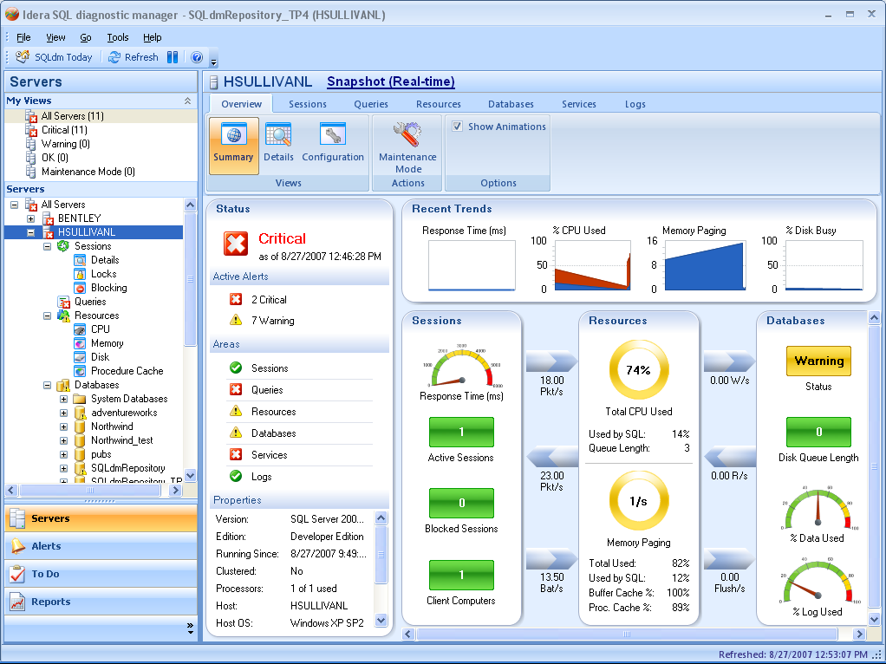
Snapshot Screenshot
www.idera.com

Slide 13
Allow user to enter any metric
Problem
  We are constantly in a metric battle with other tools or just data that particular users want collected and displayed.
  SQLmm allows users to enter any metric (perfmon or SQL counter) or query (exec master.dbo.xp_fixeddrives) and it will be collected, stored, displayed and alerted on.
Solution
  In order to give users the utmost usability and to keep us from constantly having to add metrics we need to allow the user to plug-in new metrics in to our ‘system’. The would probably need to specify a category (database info, resource, etc.)
  These metrics would be stored in our repository, alerted on, shown in our GUI (on a custom graph tab where user can select from up to 4 counters) and reported on (how?)
Scope
  Initially, we can scope the metric selection/specification and number capabilities.
  We can limit the number of user-defined metrics to some number (like 5-10)
www.idera.com

Slide 14
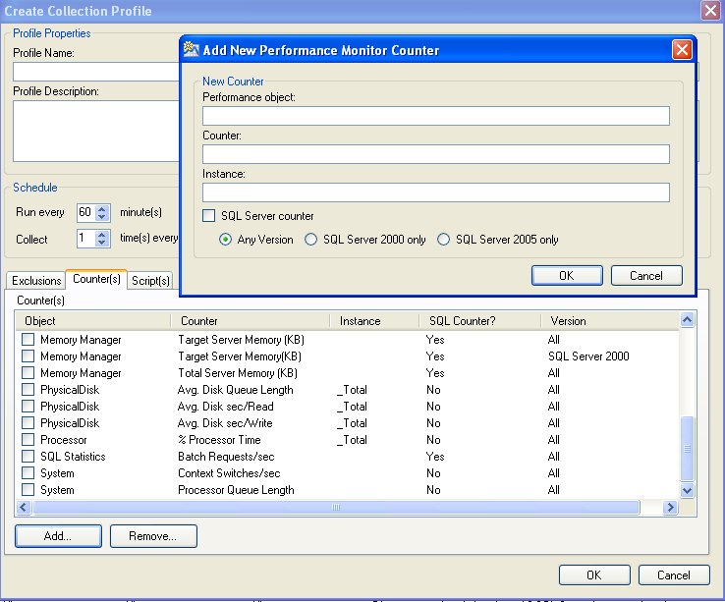
Metric Selection
Example 1
www.idera.com

Slide 15
Metric Selection
Example 2 – SQLmm
  Allows any SQL, WMI or performon counter
  Users add the counter and threshold values
  Counter is automatically added to the list of alerts, configure alerts, notifications
  User can select list to graph
www.idera.com

Slide 16
Store real-time data and have it affect alerts
Problem
  Real-time data is displayed in the GUI but not of any other ‘use’ to the user
  This data does not affect Alerts, can’t be shown or reported on in Reports, etc.
  Most users do not understand the difference between real-time and scheduled and certainly will not understand why they are treated (by DM) so dramatically different
  This has already come up quite often during previews with customers wondering how to clear alerts, wondering why alerts are still showing up when they no longer issues (portrayed in our real-time view), etc.
Solution
  We should treat real-time data the same as scheduled collection. Think of it as scheduled data just more frequently.
  This will also, hopefully, also allow us at some point to keep multiple real-time consoles from hitting the same server for the same data
www.idera.com

Slide 17
Metric thresholds based on past performance
Problem
  Users of DM 5.0 are going to be besieged with alerts in the new GUI and its very difficult, if not impossible, for them to know how to set each threshold on each servers.
  Users don’t know what is normal for their servers so its hard to set thresholds
  Servers can have very different “normal” ranges and configuring alerts to account for this is VERY time consuming
Solution
  We should allow the user to set each metric threshold explicitly (each Ok, Warning, Critical value range) or we should do it for them based on the historical data we have.
  Set alerts based on percentage deviation from normal and have a way to have DM decide what’s running normally (running average?)
  For certain metrics, we should ‘retry’ before alerting. IOW, if CPU is 95% then we should go back every 15 seconds for the next minute and if it stays in the critical range then raise the alert (or take the average???). We need to figure out some kind of ‘smoothing’.
www.idera.com

Slide 18
Worst Performing Improvements - Nice
Problem
  Worst Performing Traces can impact SQL Server performance and other options should be investigated.
  Our filters do not allow for multiple for multiple exclude filters in the UI or Trace Configuration and people do not want to collect maintenance or backup operations
Solution
  SQL Server 2005 DMV’s should be investigated to see if they are better than our current worst performing traces
  Allow users to have more control over the data we collect via our SQL Trace to reduce the amount we collect. So, allow them to exclude particular actions (like BACKUP, etc).
www.idera.com

Slide 19
Scheduled maintenance mode - Nice
Problem
  Users have periods of time during the day or week they perform scheduled maintenance or periodic testing and they want to disable collection and/or notifications during that recurring period
Solution
  When users put a server into maintenance mode, let them determine if we’re scheduling and/or notifying and if it’s a one time or recurring
  Allow users to disable
    SQLdm data collection and alerts
    SQLdm alerts only
  For timeframe:
    Until further notice
    During 2-4am Mon-Fri
    Recurring (every week from Tues 9pm-Wed 2am)
Scope
  This was initially planned for 4.5 and is something customers have been requesting since 4.5. Customers will request more than prospects.
www.idera.com

Slide 20
Strip parameters off the stored procedures in Queries - Nice
Problem
  Users have statements showing up in our worst performing queries that are simply the same store procedures with different parameters or same queries with different where clauses and we show them as being different so it’s very difficult to determine if a particular sp or query is being called over and over (most frequent).
Solution
  Allow the user to specify whether they want to strip off parameters or where clauses and roll-up the number of executions or run-times
www.idera.com

Slide 21
Reports - Nice
Problem
  Currently, our reports do not allow for easy comparative reporting between servers or two timeframes for a single server
Solution
  Provide comparative reporting capabilities
  Provide threshold values in the charts
  Let users select whether they want total, avg, etc.
www.idera.com

Slide 22
Idera Product Integrations - Nice
Look at how we can integrate various Idera products into SQLdm.
www.idera.com

Slide 23
Miscellaneous
Disk Metrics
  Disk Queue Length per disk – or at least a way to show what each disk looks like (physical or logical)
  os counter for logical disk- average disk seconds per read
  avg disk seconds per write.
  Activity and Space by individual Disks, as in showing the disk is 40% full, not whether a db or log is exceeding size constraints
  Since our servers are all connected to SANS and many of our databases as spread across multiple drives, it would be nice to see some screens that report response time, i/o rates and delays by drive letter. We recently had an issue where TEMPDB and LOG was incorrectly allocated to the same drive and was crushing the volume. We ended up finding it with perfmon.
  Monitor the servers local drives for low disk space
Activity by individual CPU, not aggregate or average
Exclude Tables from Growth and Reorg
Processor queue length
www.idera.com

